Slide 1
Module 5: Structures
ITPROG2 COMPUTER PROGRAMMING 2 FOR IT

Slide 2
STRUCTURE
A structure is a group of elements which are of different type. Each of the elements is identified by its own identifier and they are called member.
A structure can be thought of as an object without any member functions. The important property of structures is that the data in a structure can be a collection of data items of diverse types.

Slide 3
STRUCTURE
A structure variable can hold values just like any other variable can. A structure value is a collection of smaller values called member values.

Slide 4
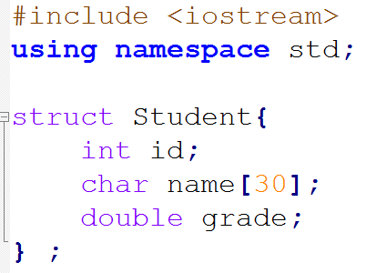
Source Code:

Slide 5
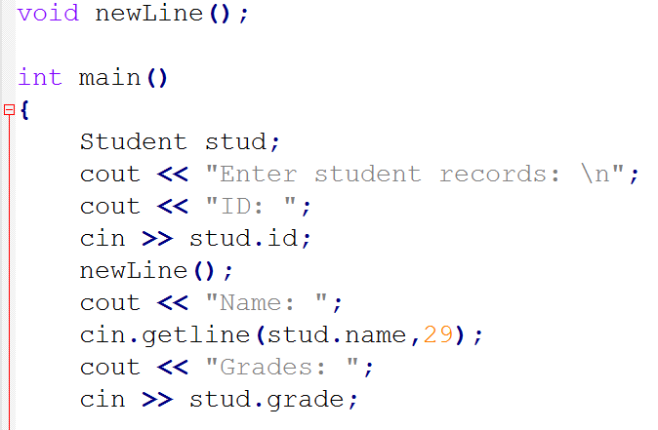

Slide 6
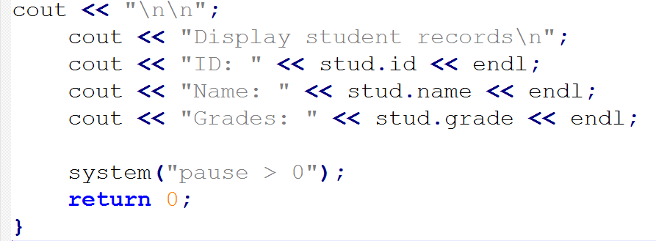

Slide 7
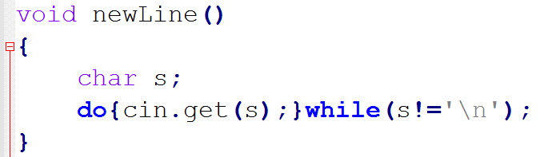

Slide 8
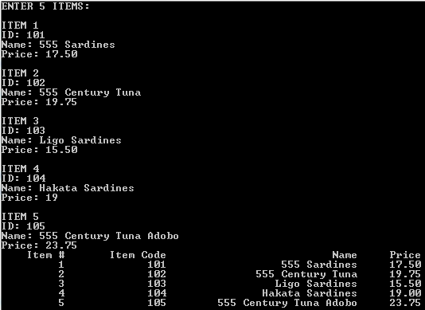
Arrays of Structure

Slide 9
Source Code:
#include <iostream>
#include <iomanip>
using namespace std;
struct item{
int id;
char name[50];
double price;
};
void newLine();

Slide 10
int main()
{
item itm[5];
int i;
cout << "ENTER 5 ITEMS:\n";
for(i=0; i<5; i++)
{
cout << "\nITEM " << (i+1) << endl;
cout << "ID: ";
cin >> itm[i].id;
newLine();
cout << "Name: ";
cin.getline(itm[i].name,49);
cout << "Price: ";
cin >> itm[i].price;
}

Slide 11
cout << setw(10) <<"Item #"
<< setw(16) << "Item Code"
<< setw(30) << "Name"
<< setw(10) << "Price";
cout.setf(ios::fixed);
cout.setf(ios::showpoint);
cout.precision(2);

Slide 12
for(i=0; i<5; i++)
{
cout << endl;
cout << setw(10) << i+1
<< setw(16) << itm[i].id
<< setw(30) << itm[i].name
<< setw(10) << itm[i].price;
}
system("pause > 0");
return 0;
}

Slide 13
void newLine()
{
char s;
do{
cin.get(s);
}while(s!='\n');
}

Slide 14
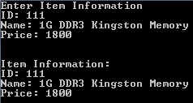
Structures and Functions

Slide 15
Source code:
#include <iostream>
using namespace std;
struct ItemRec
{
int id;
char name[50];
double price;
} item;
void inputItem();
void displayItem();
void newLine();

Slide 16
int main()
{
cout << "Enter Item Information\n";
inputItem();
displayItem();
system("pause>0");
return 0;
}

Slide 17
void inputItem()
{
cout << "ID: ";
cin >> item.id;
newLine();
cout << "Name: ";
cin.getline(item.name,49);
cout << "Price: ";
cin >> item.price;
}

Slide 18
void displayItem()
{
cout << "\n\nItem Information:\n";
cout << "ID: " << item.id << endl;
cout << "Name: " << item.name
<< endl;
cout << "Price: " << item.price
<< endl;
}

Slide 19
void newLine()
{
char s;
do{
cin.get(s);
}while(s!='\n');
}

Slide 20
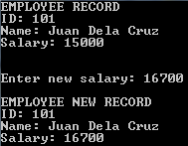
Initialization of Structure (output)

Slide 21
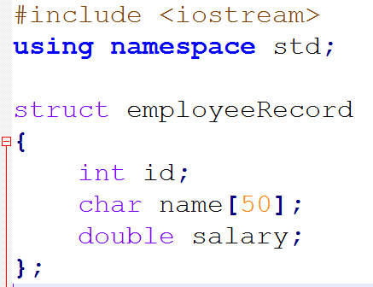
Initialization of Structure

Slide 22
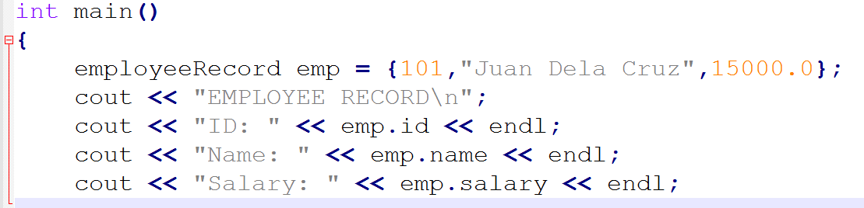

Slide 23
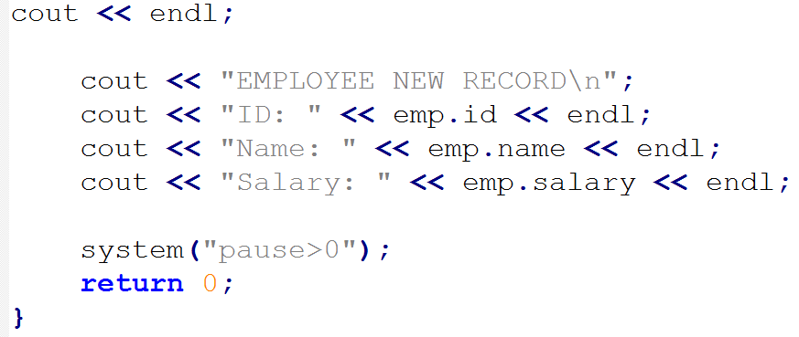

Slide 24
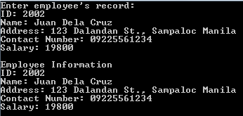
Structures and Pointers

Slide 25
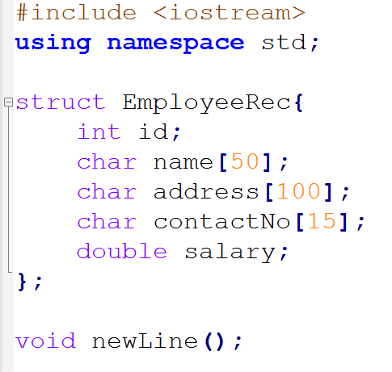
Source Code:

Slide 26
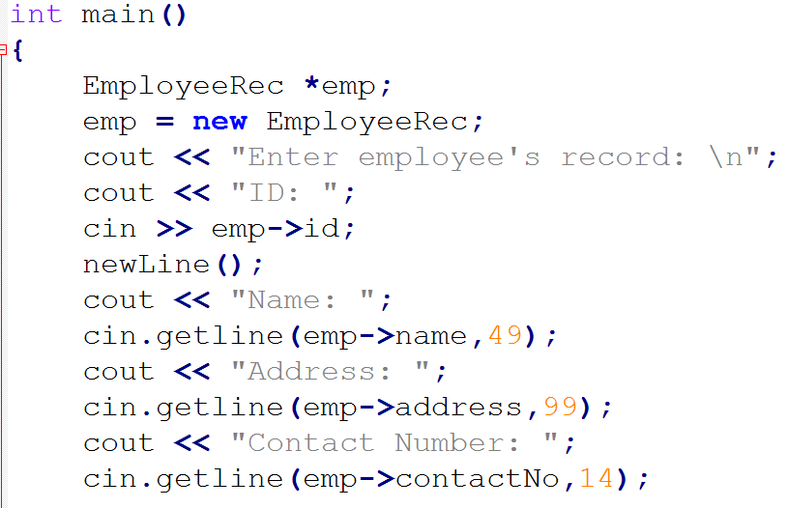

Slide 27
cout << "Salary: ";
cin >> emp->salary;
cout << endl;
cout << "Employee Information \n";
cout << "ID: " << emp->id << endl;
cout << "Name: " << emp->name << endl;
cout << "Address: " << emp->address << endl;
cout << "Contact Number: " << emp->contactNo << endl;
cout << "Salary: " << emp->salary;
system("pause>0");
return 0;
}

Slide 28
void newLine()
{
char s;
do{ cin.get(s); }while(s!='\n');
}

Slide 29
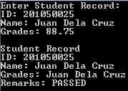
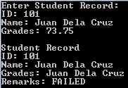
Passing Structures to Functions
Output: CASE 1 Output: CASE 2

Slide 30
Source Code:
#include <iostream>
#include <string>
#include <iomanip>
using namespace std;
struct studRecord{
int id;
char name[50];
double grades;
};
void newLine();
void showStudRecord(studRecord stud);

Slide 31
int main()
{
studRecord s;
cout << "Enter Student Record: \n";
cout << "ID: ";
cin >> s.id;
newLine();
cout << "Name: ";
cin.getline(s.name,49);
cout << "Grades: ";
cin >> s.grades;
cout << endl;
showStudRecord(s);
system("pause>0");
return 0;
}

Slide 32
void showStudRecord(studRecord stud)
{
cout << "Student Record\n";
cout << "ID: " << stud.id << endl;
cout << "Name: " << stud.name << endl;
cout << "Grades: " << stud.grades << endl;
if(stud.grades < 75)
cout << "Remarks: FAILED";
else
cout << "Remarks: PASSED";
}

Slide 33
void newLine()
{
char s;
do{
cin.get(s);
}while(s!='\n');
}

Slide 34
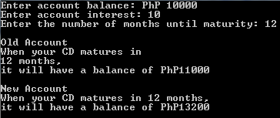
Structure Declared in a Structure

Slide 35
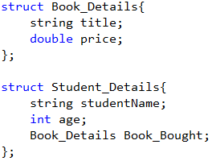
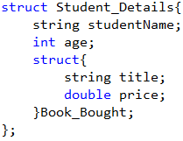
Structure within a Structure
DECLARATION 1 DECLARATION 2

Slide 36
Source Code
#include <iostream>
#include <string>
using namespace std;
struct Student_Details{
char studentName[50];
int age;
struct{
char title[50];
double price;
}Book_Bought;
};
void newLine();

Slide 37
Source Code
#include <iostream>
#include <string>
using namespace std;
struct Student_Details{
char studentName[50];
int age;
struct{
char title[50];
double price;
}Book_Bought;
};
void newLine();

Slide 38
int main()
{
Student_Details sd;
cout << "ENTER THE FOLLOWING INFORMATION: \n";
cout << "Name: ";
cin.getline(sd.studentName,49);
cout << "Age: ";
cin >> sd.age;
newLine();
cout << "Book Title: ";
cin.getline(sd.Book_Bought.title,49);

Slide 39
cout << "Book Price: ";
cin >> sd.Book_Bought.price;
cout << "\n\n";
cout << "INFORMATION DETAILS:\n";
cout << sd.studentName << endl;
cout << sd.age << endl;
cout << sd.Book_Bought.title << endl;
cout << sd.Book_Bought.price << " Pesos" <<endl;
system("pause > 0");
return 0;
}

Slide 40
void newLine()
{
char s;
do{
cin.get(s);
}while(s!='\n');
}

Slide 41
End of Module 5

